Slide 1
Predicting Renewals (Building Classification model)
BY:-Apurv Rathore

Slide 2
AGENDA
Data Preparation
Final Variables
Predictive Modelling
Evaluating Model Performance

Slide 3
Data Preparation
Removed Missing data rows as missing values are less compared to sample
After above operations, data was reduced to 653 observations and 16 variables
Normalizing the Data set

Slide 4
Final Variables
Used Boruta algorithm for feature selection
It is an improvement on random forest variable importance measure which is a very popular method for variable selection
It follows all-relevant variable selection method in which it considers all features which are relevant to the outcome variable. Whereas, most of the other variable selection algorithms follow a minimal optimal method where they rely on a small subset of features which yields a minimal error on a chosen classifier.

Slide 5
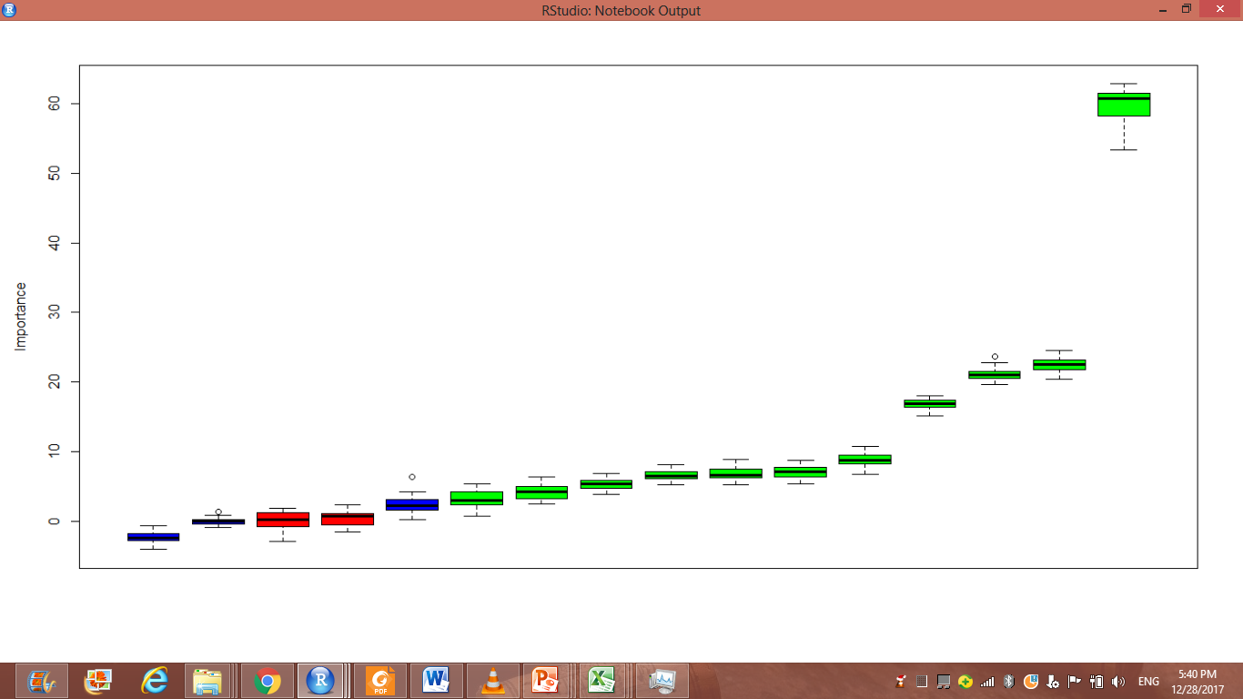
"C2" "C3" "C4" "C5" "C6" "C7" "C8" "C9" "C10" "C11" "C14" "C15“ were selected as the final variables
for model building
Correlated variables were removed before hand.

Slide 6
Predictive Modelling
At first Model was build by using all variables in data set
Random Forest was used to build a Classification Model
Accuracy measured was 87.90 & Kappa measured was 75.33
But Accuracy SD and Kappa SD were high so as to reduce these values and increase Accuracy and kappa ,build other models using important variables suggested by Boruta algorithm.

Slide 7
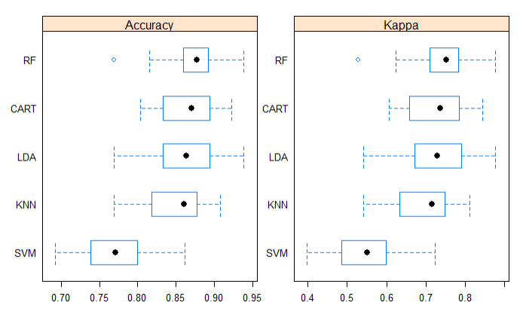
Random Forest was selected finally to build the classification model as it outperformed giving best results in comparison to other 5 models
Box Plot below shows RF as best performing

Slide 8
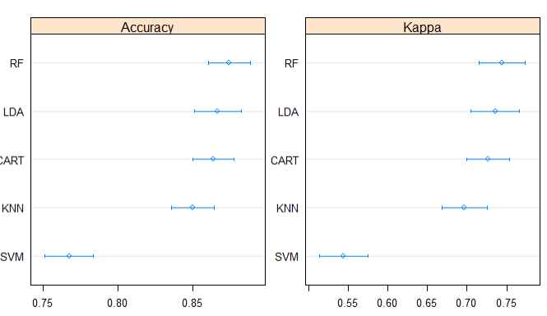
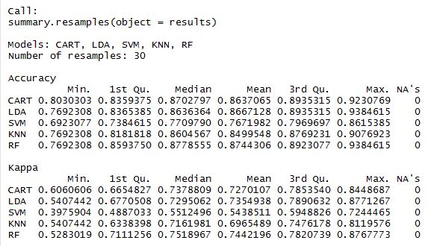
Dot plot and Summary function shows RF as clear winner so was chosen to build final model
RF Giving max Accuracy & Kappa

Slide 9
Evaluating Model Performance
Training and validation sets were created of 80% & 20%
Performance was measured on validation data by Accuracy & Kappa as measure
Accuracy because it divided the proportion of correct predictions by the total number of predictions.
The Kappa statistic (or value) is a metric that compares an Observed Accuracy with an Expected Accuracy (random chance).
Out of 130 cases in validation data only 12 were misclassified giving Accuracy of 90.77% .

Slide 10
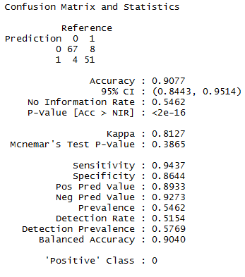
Below is shown final confusion matrix Build on Validation data

